Slide 1

DriverPass System Analysis
Hillary Loyd
Notes:
[No speaker notes required for this slide.]

Slide 2

System Requirements
Functional Requirements:
The system shall validate user credentials when logging in.
The system shall provide the user with available appointments for them to schedule
Non-functional Requirements:
The system needs to be run off the web, preferably over the cloud.
The owner wants to access data from anywhere offline and from mobile devices.
Notes:
The System would validate user credentials when logging in. The system would take the username and password the user entered, verify that the information that was entered is correct by matching the username and password to what the system has on file. This will meet DriverPass’ need by allowing each user to have a unique username and password, and every user would have their own role based on what is tied to that username and password.
The system shall provide the user with available appointments for the on-the-road training that they can schedule from. The system will have the ability to pull and up to date calender, which allows the customer or staff to schedule the appointments only at the times that are currently listed as available. This will prevent appointments from overlapping when the user or staff schedules this appointment. This will meet the need of DriverPass by allowing both users and the staff to schedule the appointments and prevents overlap of appointments.
The system needs to be run off the web, preferably on a could server. This meets DriverPass’ needs, as this type of system is what they described, and allows for less overhead.

Slide 3
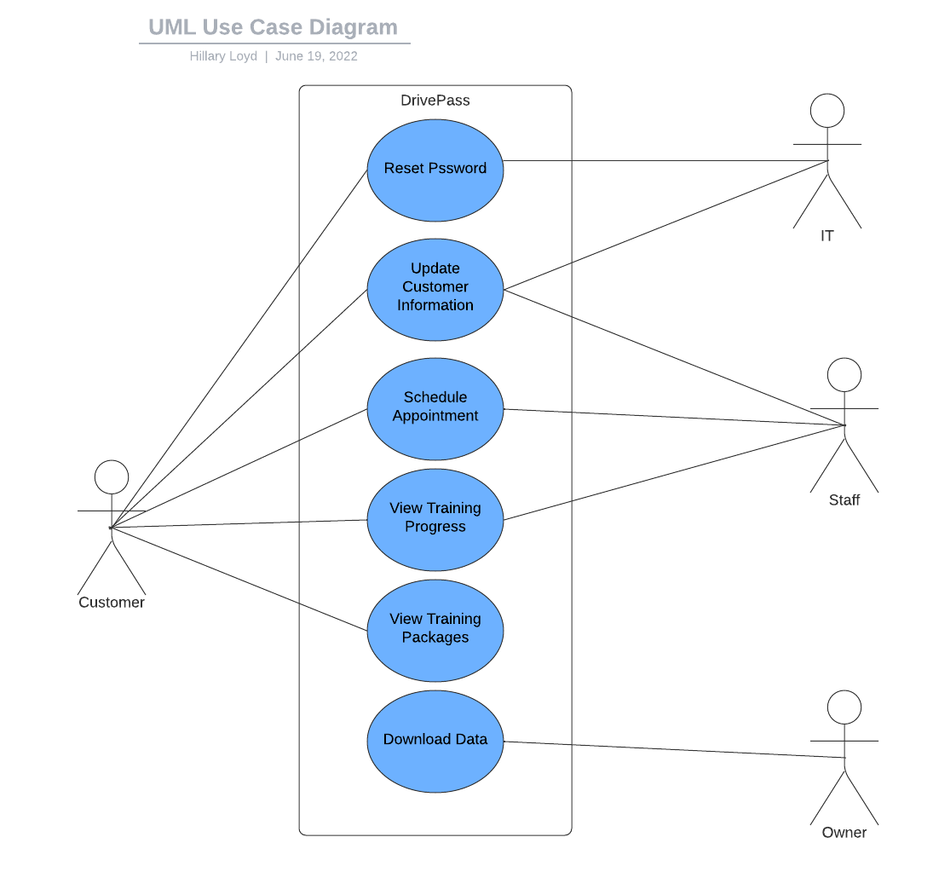
Use Case Diagram
Notes:
There are different users in our system. We have the customer, IT, staff and the Owner. The actions that can be preformed are resetting passwords, updating customer information, scheduling appointments, viewing training progress, viewing training packages, and downloading data. DriverPass needs are accounted for in all of these. The user will have the option to reset their password and update their information. IT will also need to be able to access this information. The staff will also can update the customer information as well as scheduling appointment and viewing the training progress. The user will also be able to access this information. The only person that will be able to download data is the owner. This is so that they can see this information on the go.

Slide 4
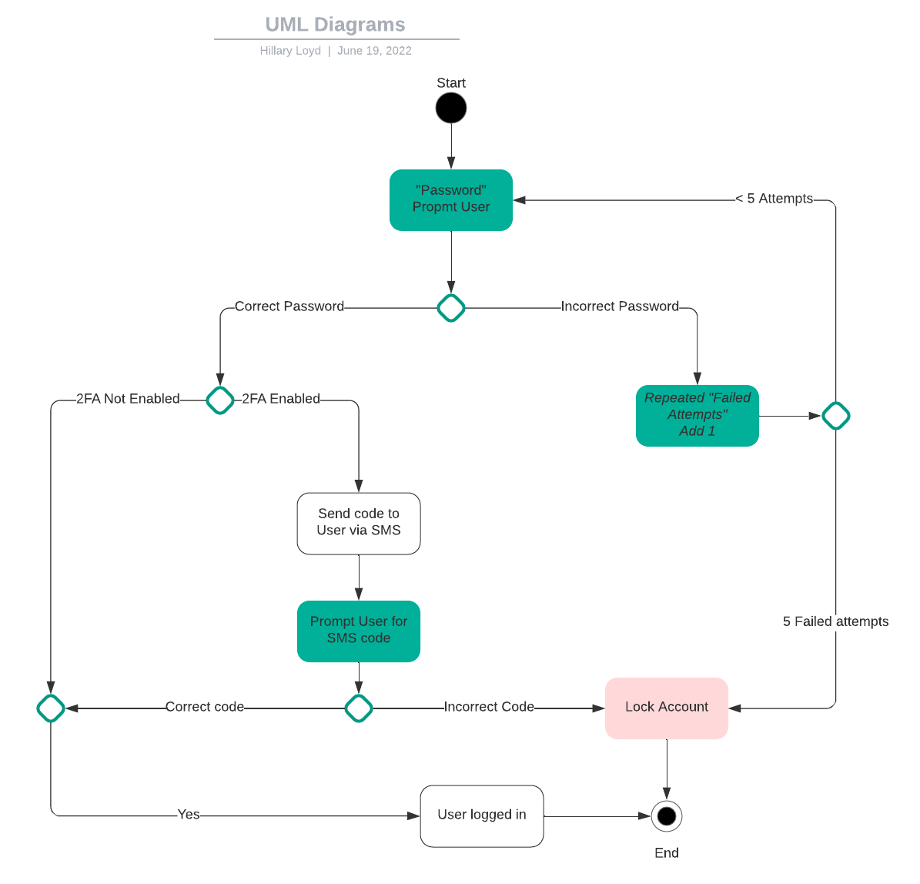
Activity Diagram
Notes:
This Activity diagram we break down they process of logging in to they system. First, we start with prompting the user for their password. If the password is incorrect in will add one attempt to the number of failed attempts made. The system will the let the user know that they password was incorrect and them ask for the password again. This process will until the user has attempted entering in the password five times. On the fifth time the account will lock and then end the process. If the user does enter a correct password the system will check to see if the user has enabled 2FA on their account. If the user has not enabled 2FA then it will log the user in. If the user has enabled the 2FA it will send a code via SMS. The system will then prompt the user for the SMS. If the SMS is entered wrong, then the system will lock the account. If the user enters in the correct code, then the user will be logged into the system.

Slide 5
Security
The User needs a username and password to be able to log in the system.
The connection would be encrypted to ensure data security.
A user will be locked out of their account after five attempts.
If the user has a 2FA, they will be asked to provide the code that was sent to them via SMS.
Notes:
Security was important in this design. While a cloud-based database will take care of security, there are still security measures that we will need to think about it. A bare minimum to security is a unique username and password. There also needs to be a way to ensure data integrity and the security of the connection between a user and our system. Locking out the user after five attempts ensures that it is only the user that is trying to log into their system. If they are lock out, then they will need to contact customer support to be able to unlock their account. We use 2FA to also ensure that it is only the user logging into the system. This adds an extra blanket of security to make sure that hackers are not trying to access and account.

Slide 6
System Limitations
Sine out consulting company is a small company, there will be limitations on resources and budget.
We are working on a timeline. This timeline is around three months.
There may be limitations in technology. This is due to the system being a web-based system, and a mobile version is only available to the owner. Other limitations in technology was not discussed.
The system has some limitations, for example, the user cannot pick their driver they want to work with for their on-the-road training. Retrieval for username and password was also not discussed.
Notes:
There are some limitations to this designs. Our consulting company is small, which means that there may be limitations to budget and resources. We are also put on a timeline with this project. This timeline is a little over three months which is not necessarily a long time. Even in an agile method this still puts stress on the company trying to produce the system in the timeline given. The system was designed with and computer-based system in mind. Being able to access the information on a web-based browser. Mobile version of the system may not be available right away for users. The user will also not have the ability to choose a driver that they would prefer for their on-the-road training. The user also does not have the ability to reset or request their username and password in the system. This could create problems as the system will lock out the user after five failed attempts.

